Slide 1

Android Intermediate Development CP2106 – Independent Software Development Project Summer Break
01
Workshop
Tutors: Ming Xuan, Qing Hong
Email: e0176881@u.nus.edu
Emails are welcomed.

Slide 2

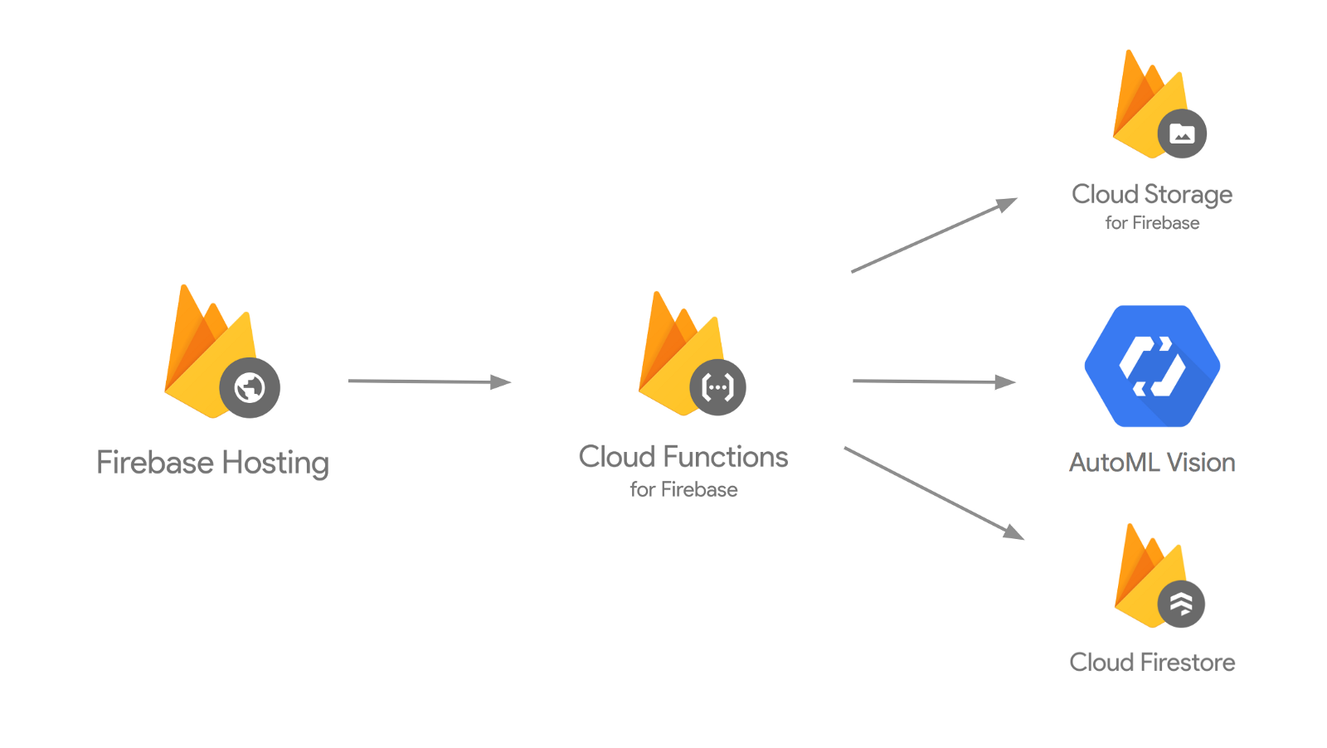
Learning Objectives
At the end of this workshop, you should understand:
Android Activity
Fragments
Navigation Drawer
Bottom Tabs
Basic Firebase concepts
Firebase Authentication
Firestore

Slide 3
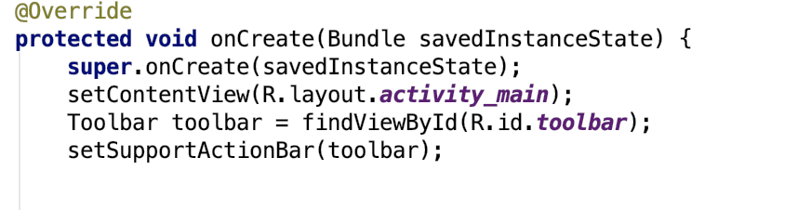
Android Activity
Activity:
Presentation layer of an android application
In charge of rendering the layout the user sees
Need to define in AndroidManifest.xml
onCreate

Slide 4
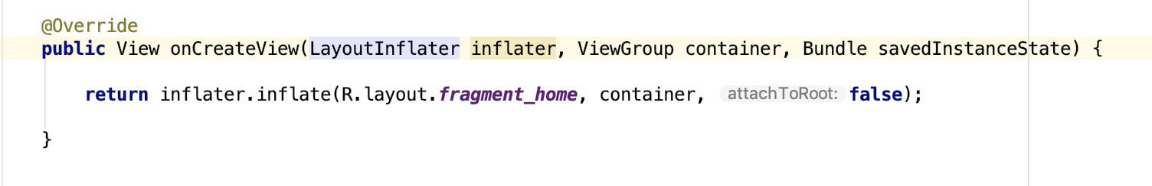
Android Fragments
Fragments:
A child of an Activity
Container( fragment are child view that you swap within container)
onCreateView
Not needed to be defined in Android Manifest
E.g Android Navigation Drawer, Bottom Tabs Activity

Slide 5
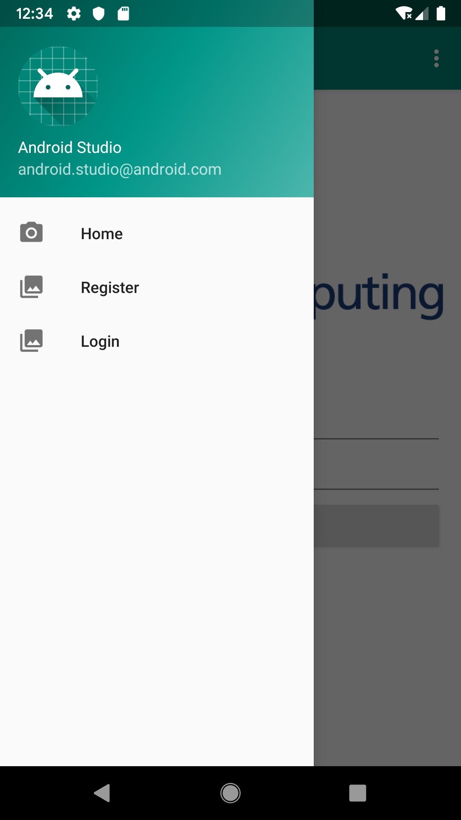
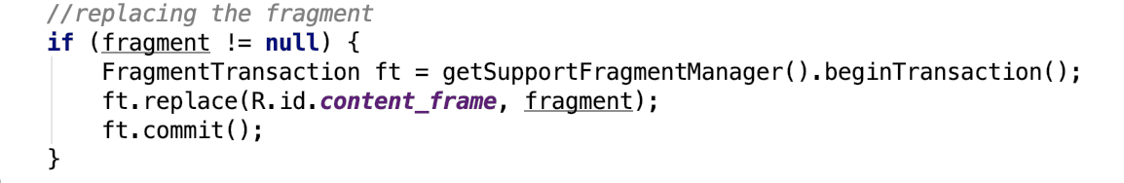
Android Navigation Drawer
Navigation Drawer:
Commonly used ui component
Activity that uses fragment to switch views
Replacing a part of a layout to a desired fragments
Method found in MainActivity displaySelectedScreen()
Layout/content_main.xml

Slide 6
Android Navigation Drawer (Exercise)
Navigation Drawer:
Change the default screen to login screen (nav_login)
displaySelectedScreen()

Slide 7
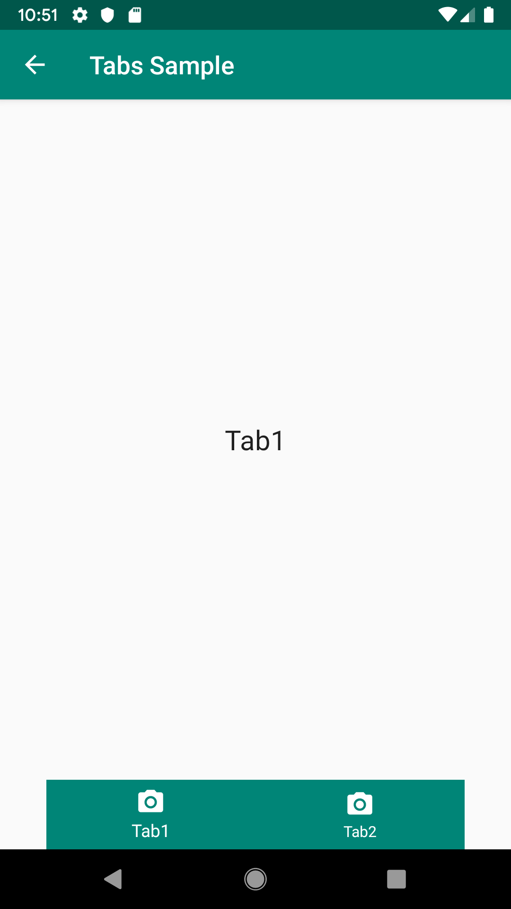
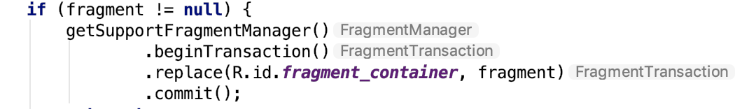
Bottom Navigation Tabs
Navigation Drawer:
Another popular used ui component
Activity that uses fragment to switch views
Replacing a part of a layout to a desired fragments
Method found in tabs/TabsActivity displaySelectedScreen()
Layout/fragment_container.xml

Slide 8
Bottom Navigation Tabs (Exercise)
Bottom Navigation Tabs:
Create a 3rd tab - Tab3
res/menu/navigation.xml
Add a new item
<item android:id="@+id/tab3" android:enabled="true" android:icon="@drawable/ic_menu_camera" android:title="Tab3" />
tabs/TabsActivity
Tab3 fragment has been created for you!
(Implement on) bottomNavigationView.setOnNavigationItemSelectedListener
Case R.id.tab3
Fragment= new Tab3();
break;

Slide 9
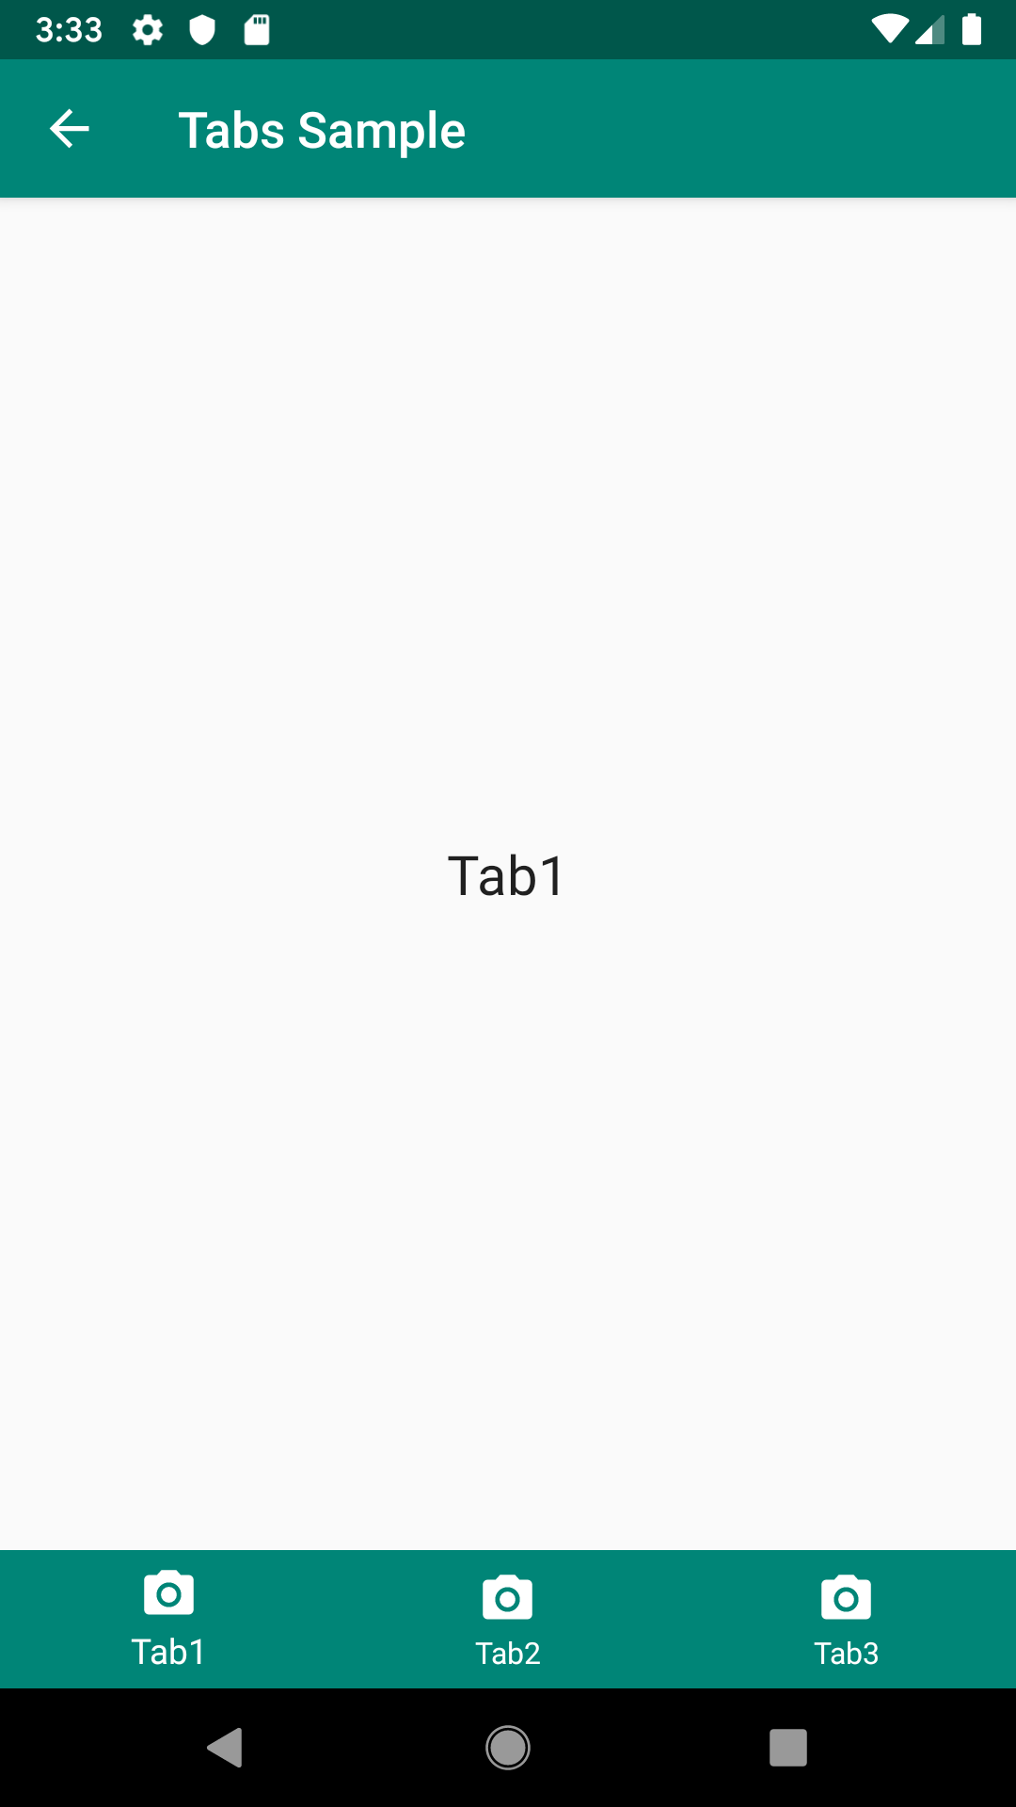
Bottom Navigation Tabs (Exercise)
Bottom Navigation Tabs:

Slide 10
Firebase Authentication
Service that can authenticate user securely
Supports Facebook, Twitter,Google etc
Supports user authentication with email and password
https://firebase.google.com/docs/android/setup#console
Register
FirebaseAuth.getInstance().createUserWithEmailAndPassword(email, password)
Login
FirebaseAuth.getInstance(). signInWithEmailAndPassword(email, password)
Reset Password
FirebaseAuth.getInstance(). sendPasswordResetEmail(email)

Slide 11
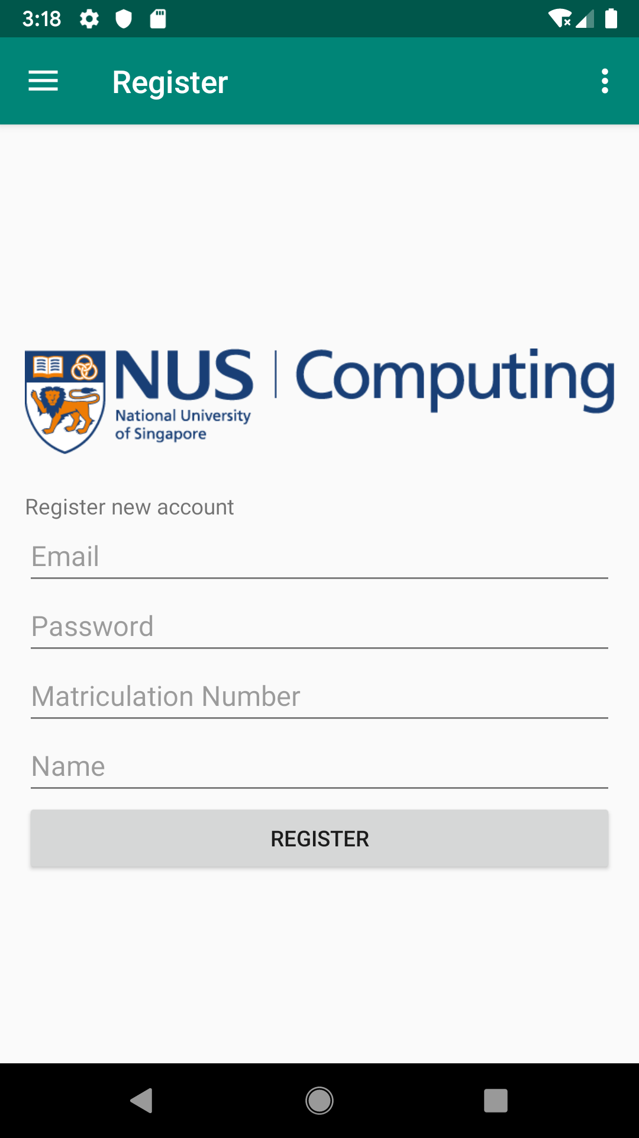
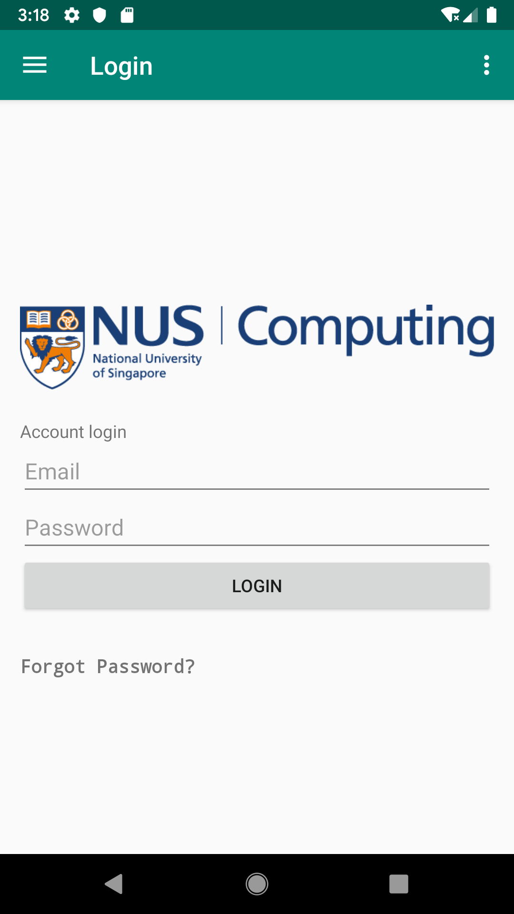
Firebase Authentication (Cont.)
FirebaseAuth.getInstance().createUserWithEmailAndPassword(email, password)
FirebaseAuth.getInstance(). signInWithEmailAndPassword(email, password

Slide 12
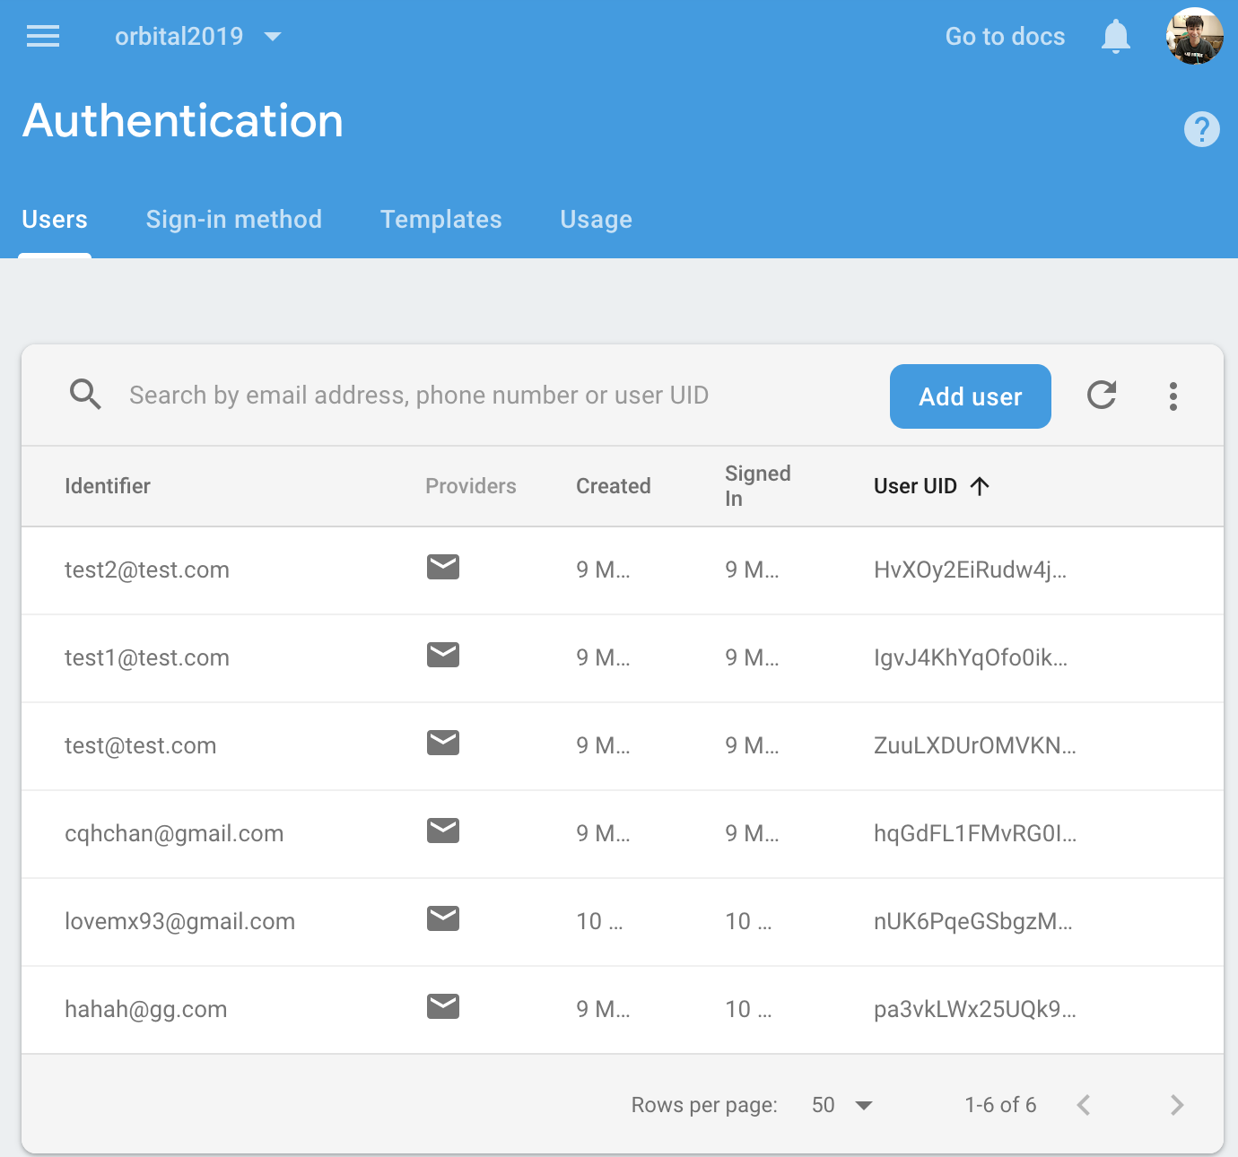
Firebase Authentication (Cont.)
User management system
Credentials registered will be stored

Slide 13
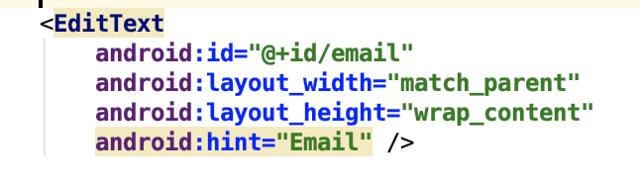
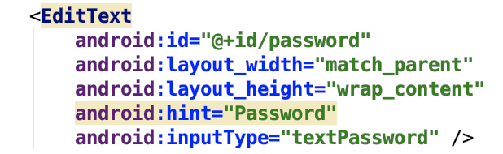
Firebase Authentication (Exercise.)
Exercise
Implement Login (fragment_login.xml)
EditText for email
EditText for password

Slide 14
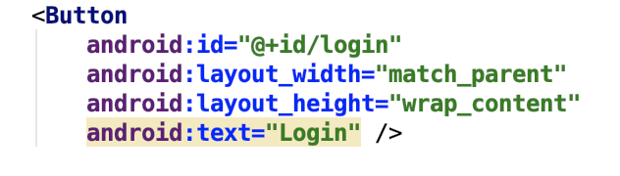
Firebase Authentication (Exercise.)
Login Button
Intermediate/auth/LoginFragment
Look for instantiate components here
Remove /* */

Slide 15
Firebase Authentication (Exercise.)
loginBtn.setOnClickListener
LoginUserAccount();
//Look for your logincode here
mAuth.signInWithEmailAndPassword(email, password) .addOnCompleteListener(new OnCompleteListener<AuthResult>() { @Override public void onComplete(@NonNull Task<AuthResult> task) { if (task.isSuccessful()) { Toast.makeText(getActivity().getApplicationContext(), "Login successful!", Toast.LENGTH_LONG).show(); progressBar.setVisibility(View.GONE); FragmentTransaction ft = getActivity().getSupportFragmentManager().beginTransaction(); ft.replace(R.id.content_frame, new HomeFragment()); ft.commit(); } } });

Slide 16
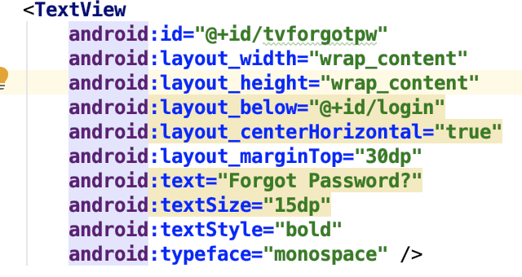
Firebase Authentication (Exercise.)
ResetPassword
Add a resetPassword textview to login_fragment

Slide 17
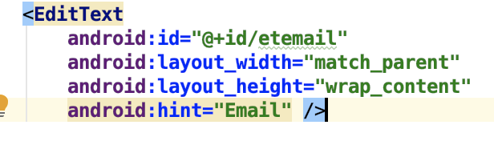
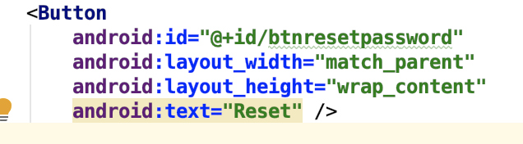
Firebase Authentication (Exercise.)
Exercise
Implement Reset Password (fragment_resetpassword.xml)
EditText for email
Reset Password Button
Analyse forgotPw.setOnClickListener

Slide 18
Firebase Authentication (Exercise.)
(Intermediate/auth/ResetPasswordFragment)
Look for instantiate components here
Remove /* */
resetBtn.setOnClickListener
resetUserAccount();
//your resetpassword code here
FirebaseAuth.getInstance(). sendPasswordResetEmail(email) .addOnCompleteListener(new OnCompleteListener<Void>() { @Override public void onComplete(@NonNull Task<Void> task) { if (task.isSuccessful()) { Toast.makeText(getActivity().getApplicationContext(), "New password sent to email!", Toast.LENGTH_LONG).show(); } } });

Slide 19
Firebase – Realtime database
A service that provides a realtime database
Data will be stored in the cloud, allowing data to be synchronised across multiple platforms ( web, mobile)
Easily accessible using REST API
JSON based

Slide 20
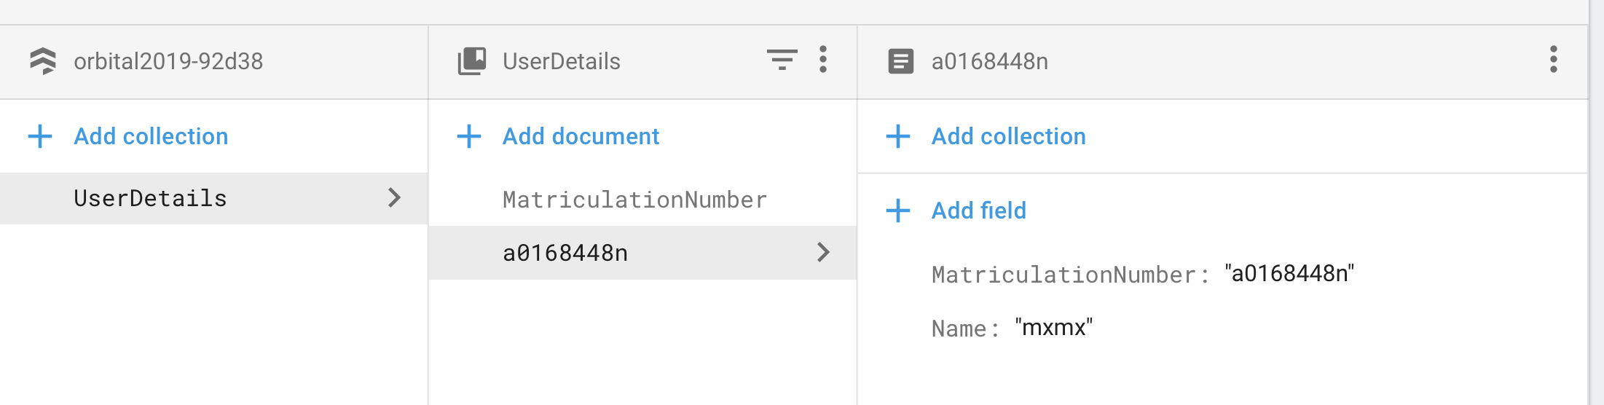
Firebase - Firestore
Successor to firebase realtime database
Uses collections and documents
Allows for nested document and fields
Able to perform more complex searches.
Example of Firestore data structure

Slide 21
Firestore – Set up
Add these code under the main activity (or first activity that loads when app launch)
//Firestore Setup FirebaseFirestore firestore = FirebaseFirestore.getInstance(); FirebaseFirestoreSettings settings = new FirebaseFirestoreSettings.Builder() .setTimestampsInSnapshotsEnabled(true) .build(); firestore.setFirestoreSettings(settings);

Slide 22
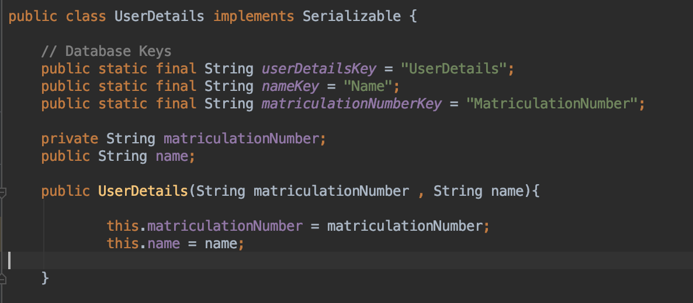
Firestore – Creating the class
Creating User Information
What are the keys for?

Slide 23
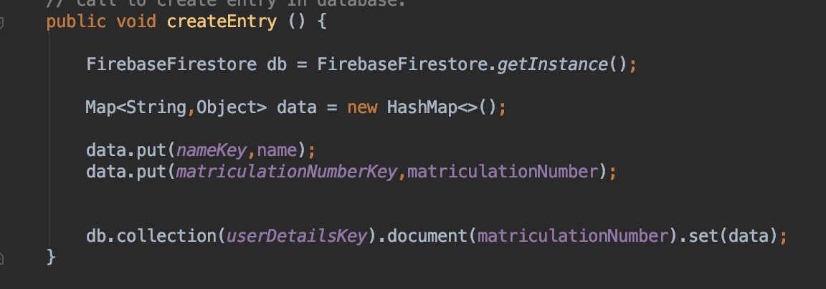
Firestore – Add to database
Create entry in database

Slide 24
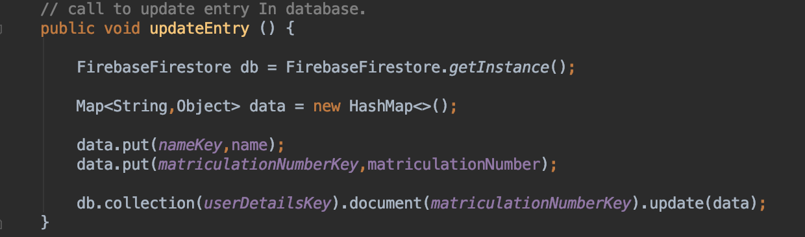
Firestore – Edit database
Edit entry in database
Only affects the keys in data. Anything else remains unchanged

Slide 25
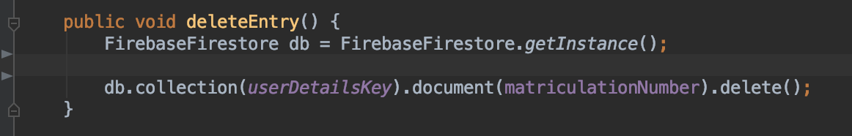
Firestore – Delete entry
Delete entry in database

Slide 26
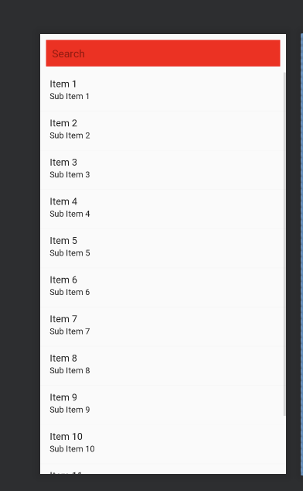

Firestore – Displaying User Details
Listview with adapter
List view into XML File
Detail Row xml file.
Show how to content will be displayed
The 2 files will be linked with an adapter class (next page)

Slide 27
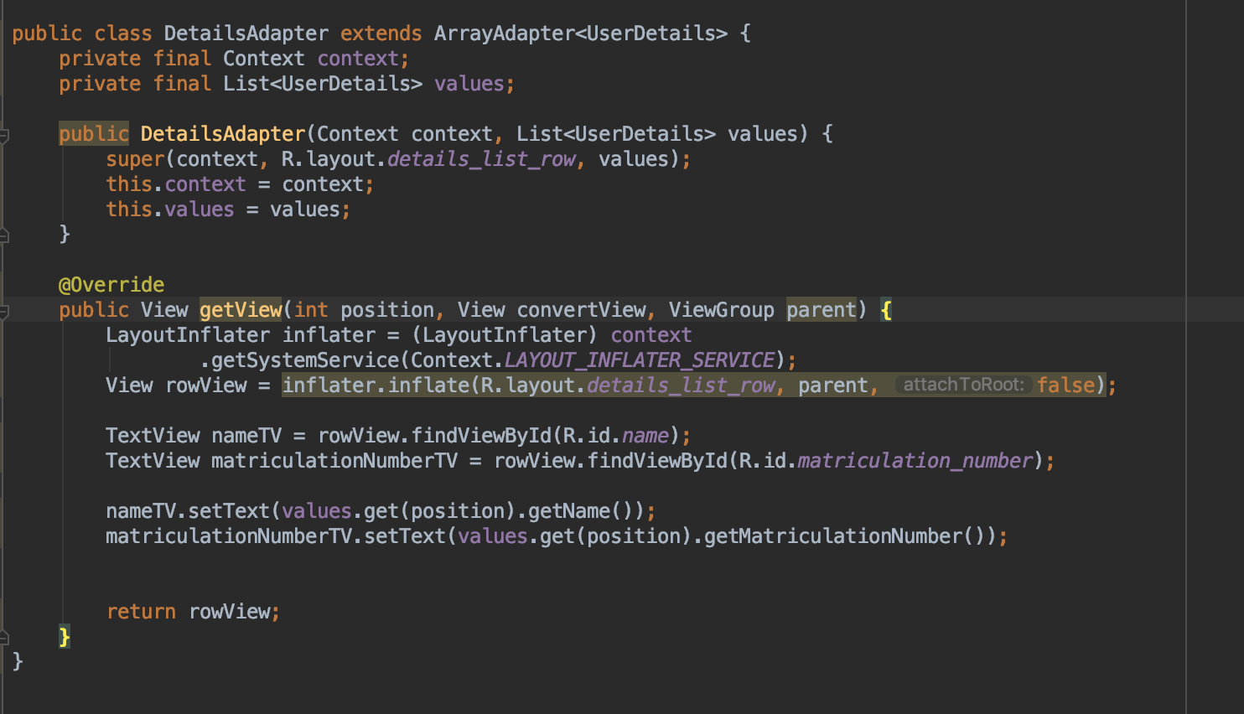
Firestore – Displaying User details cont 1

Slide 28
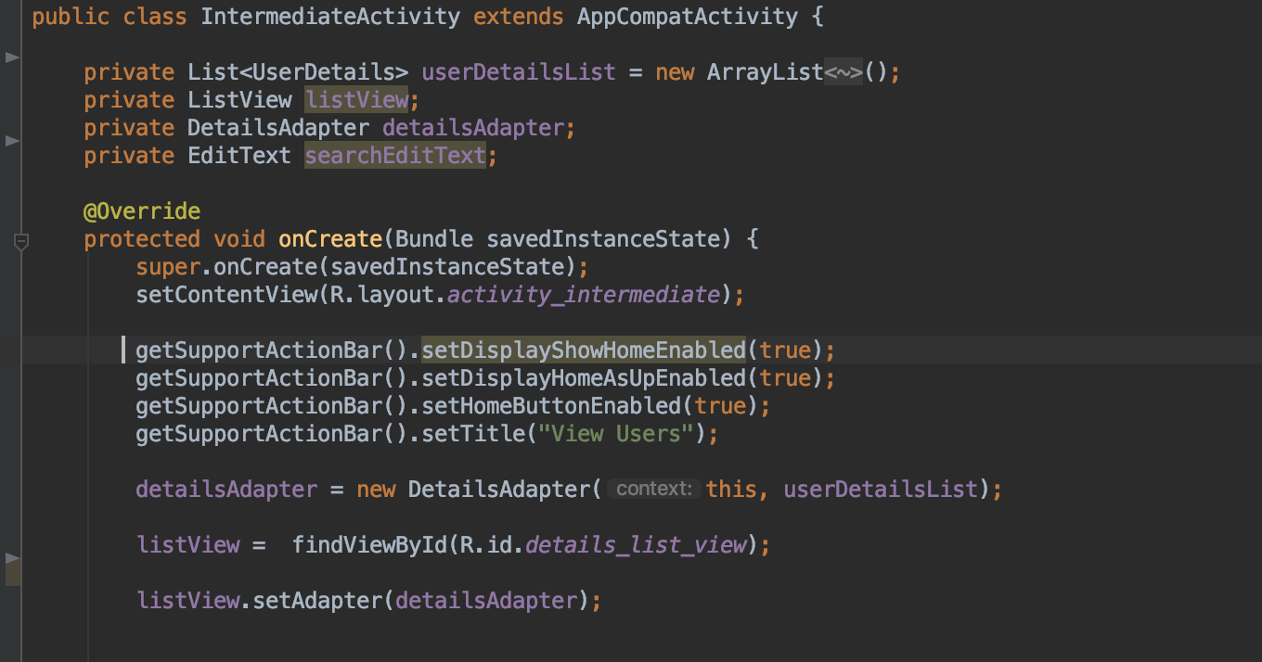

Firestore – Displaying User details cont 2
How do we bring the listview and the adapter together?

Slide 29
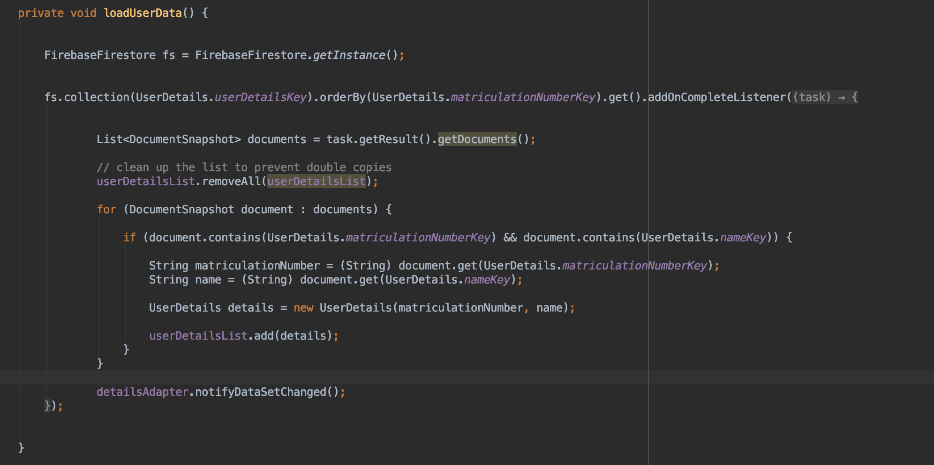
Firestore – Retrieving User data
How do we retrieve the user data from firestore?

Slide 30
Firestore – Query for selected User data
How do we retrieve the user data from firestore?

Slide 31
Firebase – firestore (Cont.)
Update / Delete User Information
Serializable Intent
Layout
Textview and Editview
Reset Password
FirebaseAuth.getInstance().sendPasswordResetEmail(email)

Slide 32

Q&A

